Slide 1
Pacific States
0
200
0
100 mi
0
200
0
100 km
0
100
200
300 mi
0
100
200
300 km

Slide 2
I am sure you want to create the following types of slides.
This is what vector images can do.
You can change the colors, font and add effects and so on….

Slide 3
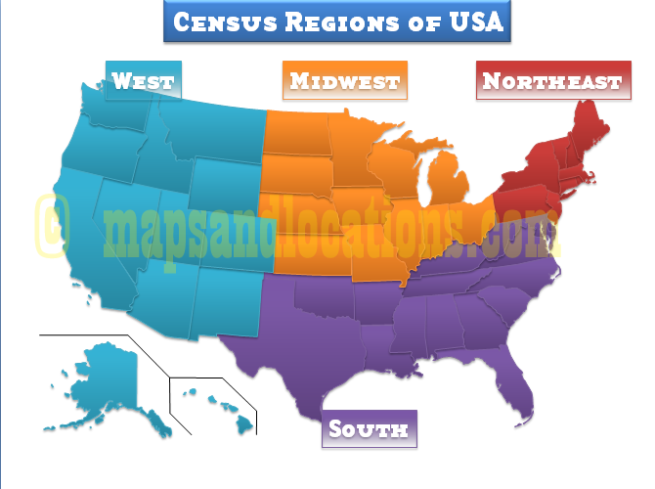

Slide 4
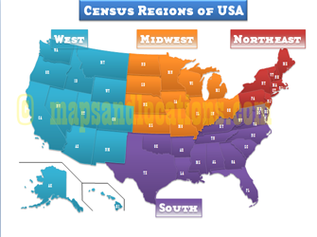

Slide 5
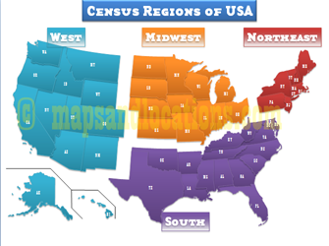

Slide 6
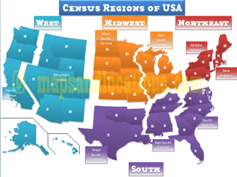

Slide 7
These are not vector, my sincere apologies.
You want to buy them, available at $9.95, in structured layered format. The small state abbreviations in separate layers, so that you can change the typeface, size and so on.
Other websites cell at $50 to $150. We give you at $9.95.

